Slide 1
Risk & Resilience Discovery Discussion Presentation
2022
Natural risk based decisions

Slide 2
KRisk
Grant Kennedy
07879 685121
grant.kennedy@krisk.co
Nicola Brannan
Nicola.brannan@krisk.co
Gerry Donaldson
Gerry@krisk.co
We empower businesses to
Maximise Opportunities and Minimise Threats through our tested solutions
Knowledge Transfer
Communication
RISK AND RESILIENCE
People Performance

Slide 3
The Risk & Resilience Discovery Solution

Slide 4
The Risk & Resilience Discovery Concept
Risk & Resilience Discovery Overview
KRisk help clients of all sizes, across many industries, to support them manage their risks responsibly through an integrated Risk and Resilience Management (RRM) approach.
We all recognise the importance of human and cultural aspects in achieving effective RRM. However, Risk & Resilience Managers continually highlighted ‘People’ as the biggest blocker to them achieving effective value adding RRM.
This was a constant source of frustration for us and our clients and we needed to help them break the wheel of uncertainty; we needed a better way to consider the ‘human factor elements of regulations, so we began our development of our Risk Discovery with our developer.
The benefits are to allow you to better understand your talent pool, potential and trends, stress, ethics and values alignment to the organisations, performance blind spots. This information is available at a touch of a button. With this valuable risk information you are able to better manage your people risk and break the wheel of uncertainty.
In 2018 we launched Risk Discovery solution and have used the solution extensively through our training and awareness programmes. Risk Discovery has been carefully aligned to risk management professional standards and international standards and have been incorporating it to our integrated approach ever since…

Slide 5
What is Risk Discovery?
Risk & Resilience Discovery Overview
A triple lens view of a person:
firstly, it details how they think and make risk-based decisions, their life attitude and the gears of their emotional intelligence.
secondly, the Discovery process reveals the person’s Values and Motivators to determine where they derive their energy to engage and their desire to succeed.
finally, the person’s observable behaviours are detailed in order to predict the best environment for them to thrive.

Slide 6
How does it work?
Risk & Resilience Discovery Overview
We use science to determine who a person truly is.
Many others will tell you there are 16 personality types… we don’t!
That narrow viewpoint simply labels your people; we set them free. Our Nobel Prize Nominee algorithm uses 6.4 quadrillion permutations to identify 282 trillion variations in the human psyche.
We then build awareness in the individual and provide insight for the organisation to manage and develop them correctly.

Slide 7
What would you use it for?
We have used this technology powered by CCR3 through all the Risk & Resilience Academies. It has been used for clients & partners including UK Finance, the Institute of Risk Management. Dubai Police, Meta, Telus, NASA, Rolls Royce, Amentum, Aviation & Aerospace & national governments.
These organisations share the same ambition – to truly understand their people and teams. In addition to using the Discovery for recruitment and retention, they want to accurately measure and select key risk hot spot areas.
We give them confidence about the talent and capability programmes that ultimately protect their investments.
The Discovery provides a solution to evaluate busines risk, personnel risk, wellbeing and opportunity risk.

Slide 8
Drivers for Use - I
Risk & Resilience Discovery Overview
Human & cultural factors is a core part of the international risk management standard. When developing a positive risk culture, it is essential to have sufficient diversity of perspectives.
By gaining an in-depth insight into the risk intelligence that exists, Risk Discovery enables an organisation to:
Better understand employees:
what drives them?
what discourages them?
what is their level of risk awareness?
what is their predisposition towards risk?
Unlock the triggers to maximising its people’s potential
Improve strategy implementation and achievement of objectives through its people
Build a positive, proactive risk and resilience culture

Slide 9
Drivers for Use - II
Risk & Resilience Discovery Overview
By gaining an in-depth insight into the risk intelligence that exists, Risk Discovery enables an organisation to:
Implement the people related aspects of ISO 31000 & Operational Resilience
Identify potential risk hot spots for targeted risk management activity and incident and claims prevention
More effectively rollout new initiatives and encourage desired behaviours
Consider people’s ‘normal’ and ‘adapted’ behaviours to better manage major incidents and crisis
Build individual resilience, team resilience and ultimately organisational resilience

Slide 10
Learning Solution

Slide 11
The Process
Risk & Resilience Discovery Overview

Slide 12
The Profile
Risk & Resilience Discovery Overview
Three-part report, designed to give insight into a person from three separate but intrinsically linked areas:
How people think and make risk based decisions: when it comes to risk, people firstly have a personal perception of risk, made from your sensation and attention. Behaviours you display are made by value judgements of your perceptions – this is your reality and ultimately, is the base of your risk based decision making!
The values and motivations a person has about the decision they’ve just made. These values fuel and determine levels of engagement and performance.
The behaviours: It’s the two previous insights that create the third, therefore enabling us to more accurately predict what a person’s risk behaviour in any given situation is likely to be.

Slide 13
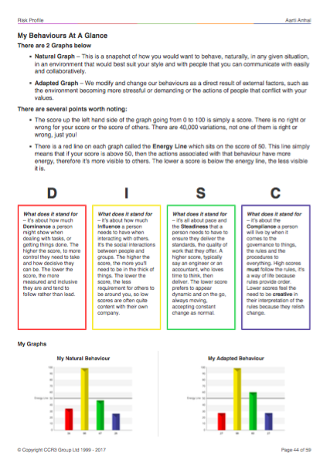
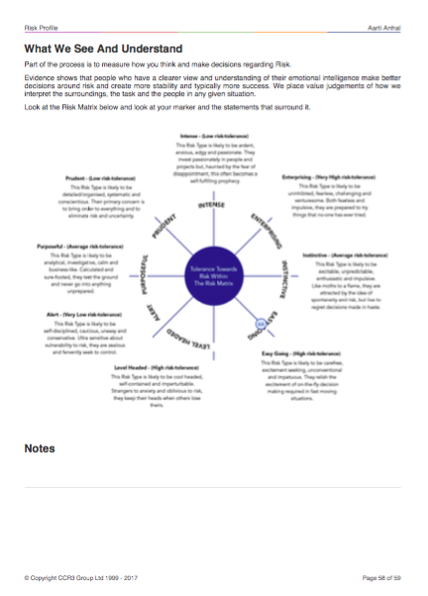
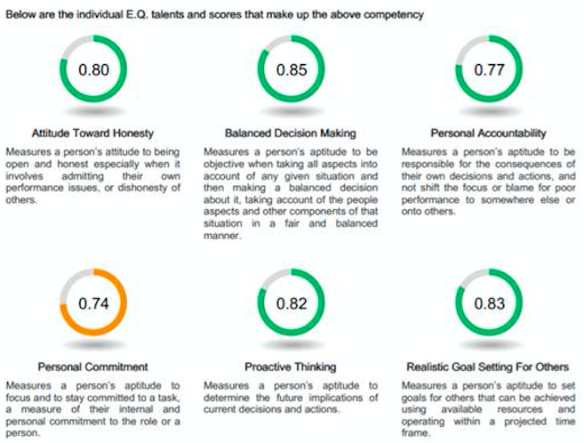
The Profile
Risk & Resilience Discovery Overview

Slide 14
Risk Discovery online

Slide 15
Welcome to the KRisk Portal
KRisk are working with CCR3 Group to help build the competencies required by all risk professionals. You have been directed to this portal because we know what’s required and we’ve created an easy, cost effect way to achieve it.
Option 1
Fundamentals is about getting a snapshot of your attitude towards risk and seeing how your thinking and decision making affect all your risk decisions. We help you identify how you make risk decisions and then develop your emotional intelligence on 4 specific topics that every risk professional should excel at.
iCoach Platform for 30 Days
Fee: £49.00
Option 2
Fundamentals Plus is where we go further in helping you understand your motivations that give the energy towards everything you do. It looks deeper at the thinking and decision making and covers additional topics on iCoach from Fundamentals and is targeted at the professional who is looking for greater self-awareness and want to develop their emotional intelligence to perform better.
iCoach Platform for 45 Days
Fee: £149.00
Option 3
Fundamentals Elite is about raising your game when it comes to risk fundamentals. You receive a self-awareness profile that illuminates you to the highest level. It details communication insights, strengths and engagement, management and communication insights that help you be at the best you can be. iCoach takes on people and life skills and is designed to make you stand head and shoulders above your peers.
iCoach Platform for 60 Days
Fee: £249.00
Start
Start
Start

Slide 16
Client Examples and Partnerships

Slide 17
Value adding examples
Risk & Resilience Discovery Overview
Many clients have experienced the value Risk Discovery can bring their organisation. In this section we present:
Details of how a major bank has used the Risk Discovery
Additional examples of others we have recently worked with
An endorsement from a recent piece of work we did for Luton Airport
Details on KRisk’s key partners in the Risk and Resilience space

Slide 18
Bank Case Study
Risk & Resilience Discovery Overview
Created bespoke profiles covering 4 strategic levels of Executive
Identified the best way in which that executive could learn and develop for change
Provided the insight for dynamic coaching covering Risk, Leadership & High Performance
Enabled Cultural shift to embed best practice
Created greater self-awareness of own impact on others and operations
Provided measurement process to allow analytics

Slide 19
Client Results
Risk & Resilience Discovery Overview
Large Utility Provider
Identification of insider threat hot spots for targeted risk management activities.
Tour Operator in Scotland
Improved understand of individual team members predisposition to risk; better risk culture across the organisation.
Private School in England
Using risk intelligence to build individual resilience and support a significant change management project.

Slide 20
Endorsement: Luton Airport
Risk & Resilience Discovery Overview
“As Head of Aerodrome Operations at London Luton Airport I lead a team of 68 staff. Within the structure I have a leadership team of 28 at various levels of seniority and responsibility.
The department had been through a lot of change particularly over the last 4 years. Despite making significant headway one of the things that we struggled with throughout this period was the varying degree of uncertainty amongst the leadership team in decision making and particularly in making risk based decisions – these were generally referred to me as head of department and I needed to understand why as the team in every other respect were fully committed and positive in their outlook.
The leadership team comprises individuals relatively new to leadership and others with 20+ years of experience in leadership roles…

Slide 21
Endorsement: Luton Airport
Risk & Resilience Discovery Overview
I was introduced to the Team and within minutes of speaking with Dr Aarti Anhal, knew the issue I was grappling with was fully understood. I didn’t feel that the team were ‘broken’ in any way, just ‘hesitant’ and I simply wanted to give them the tools and confidence to be effective as leaders and the resilience to deal with day to day pressures irrespective of their origin.
I initially gifted the 5 most senior managers with one on one coaching, the first stage of which was the Risk Intelligence Discovery Process. This proved to be the foundation of a change that far exceeded my expectation and the expectation of 20 team members that have completed the process to date. Witnessing the change compelled me to undertake the process myself, I highly recommend it as I know my team have benefitted from my personal participation.
2020 has been particularly hard on the aviation industry, the operations team have confidently navigated their way through significant challenges, have delivered one of our best regulatory audits and have inspired other departments in making the very best of all of the ongoing challenges through their decisiveness, sound risk based decision making and most importantly, their actions. I am no longer the day to day decision maker!”

Slide 22
Key Partnerships
Risk & Resilience Discovery Overview
KRisk’s experience, credentials and leading-edge approaches to risk and resilience management have enabled key partnerships to grow. Two of the most significant are:
UK Finance
We are privileged to have developed the UK Finance Risk and Resilience Academy which was rolled out in 2020 with much success and will continue into 2021.
Institute of Risk Management
The Institute has used our tools and workshops for many years both as part of public, online courses and in-house training engagements with clients.

Slide 23
Technology solution

Slide 24
The Technology
Risk & Resilience Discovery Overview
Continuous design & development :
Dr William Moulton Marston (DISC), Dr Edward Spranger (Values & Motivators), Dr Robert Hartman (Nobel Prize nominee)
Specifically & exclusively designed for business & now further developed for Enterprise Risk
Process:
Establishes how a person thinks & makes decisions, with 6.4 Quadrillion permutations, with >90% accuracy
Everyone's risk profile can be measured!
Independent studies:
Over 4 million data sets to check patterns so it is not possible to skew the process – it will be flagged as a person in stress, cheating or lack of understanding
Valuemetric v Psychmetric:
Our process is the most modern non-ipsative on the market with applied mathematics at its heart
Typical Psychometric tools only look at output behaviours.
Risk Discovery looks deeper, it asks the WHY! What truly motivates you - your values.

Slide 25
What’s included
Risk & Resilience Discovery Overview
Dashboard – a single dashboard that has all the information in one place. Permission based with 2FA, makes managing your data safe, secure and resilient.
Discovery process – the worlds most advanced, triple lens assessment of a person’s character, fully integrated to create competency mapping and benchmarking.
iCoach – An integrated emotional intelligence development tool, designed to increase the consistency and capability of your people.
iPulse – A diagnostic that looks at the health of the organisation, teams, leadership, stress, innovation, wellbeing and highlights risk areas and causes that can feed into your risk registers.
E.Q Behavioral competency mapping – Emotional intelligence drives the capability of your talent so mapping those required behaviors to how your people and teams think helps you manage risk and resilience.
Risk Intelligence – Identifies individual predisposition to risk and the overall teams and organisations approach, highlighting strengths and weaknesses and if there is sufficient diversity of perspective.

Slide 26
Engagement
Risk & Resilience Discovery Overview

Slide 27
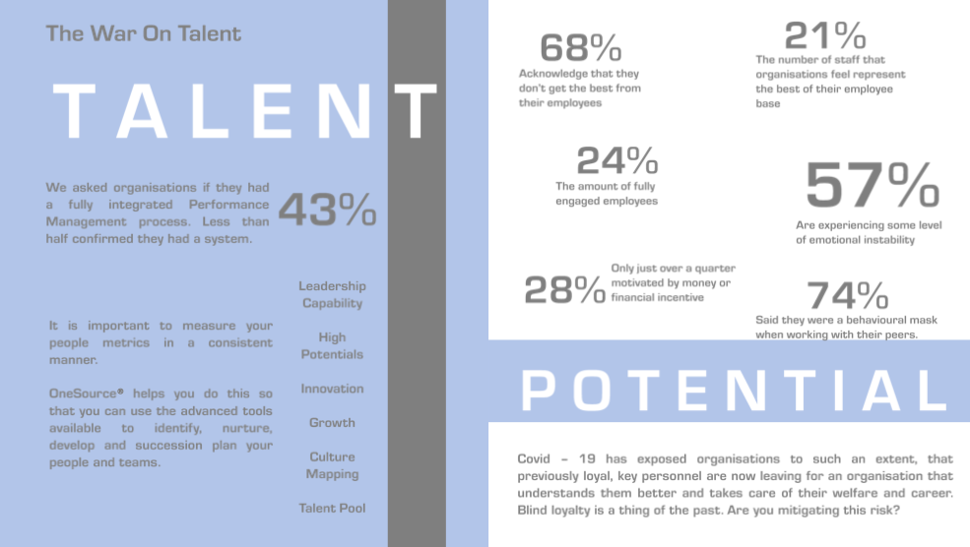
Talent
Risk & Resilience Discovery Overview

Slide 28
Integrated
Risk & Resilience Discovery Overview

Slide 29
Oncsource
Risk & Resilience Discovery Overview

Slide 30
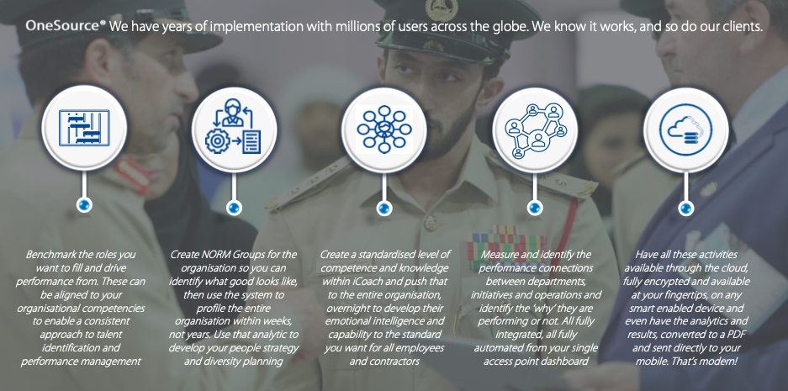
Onesource
Risk & Resilience Discovery Overview

Slide 31
Oncesource
Risk & Resilience Discovery Overview

Slide 32
Culture

Slide 33
Grant Kennedy: 07879 685121
grant.kennedy@krisk.co
Nicola Brannan: Nicola.brannan@krisk.co

